Slide 1
Analytics & Data Science: Unleashing the Power of Data
Understanding Key Concepts, Industry Applications, and Best Practices

Slide 2
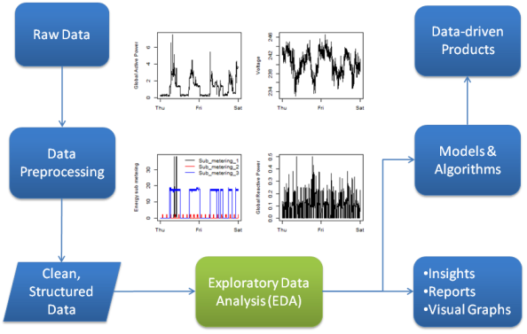
The Power of Data: Analytics & Data Science

Slide 3

In today's data-driven world, organizations are collecting more data than ever before. But data itself is useless unless we can extract insights from it. This is where analytics and data science come in. Analytics is the process of analyzing data to understand trends, patterns, and relationships. Data science is a broader field that encompasses analytics, as well as techniques for building models and making predictions. In this presentation, we will explore the world of analytics and data science, and learn how they can be used to solve business problems and gain a competitive advantage.

Slide 4
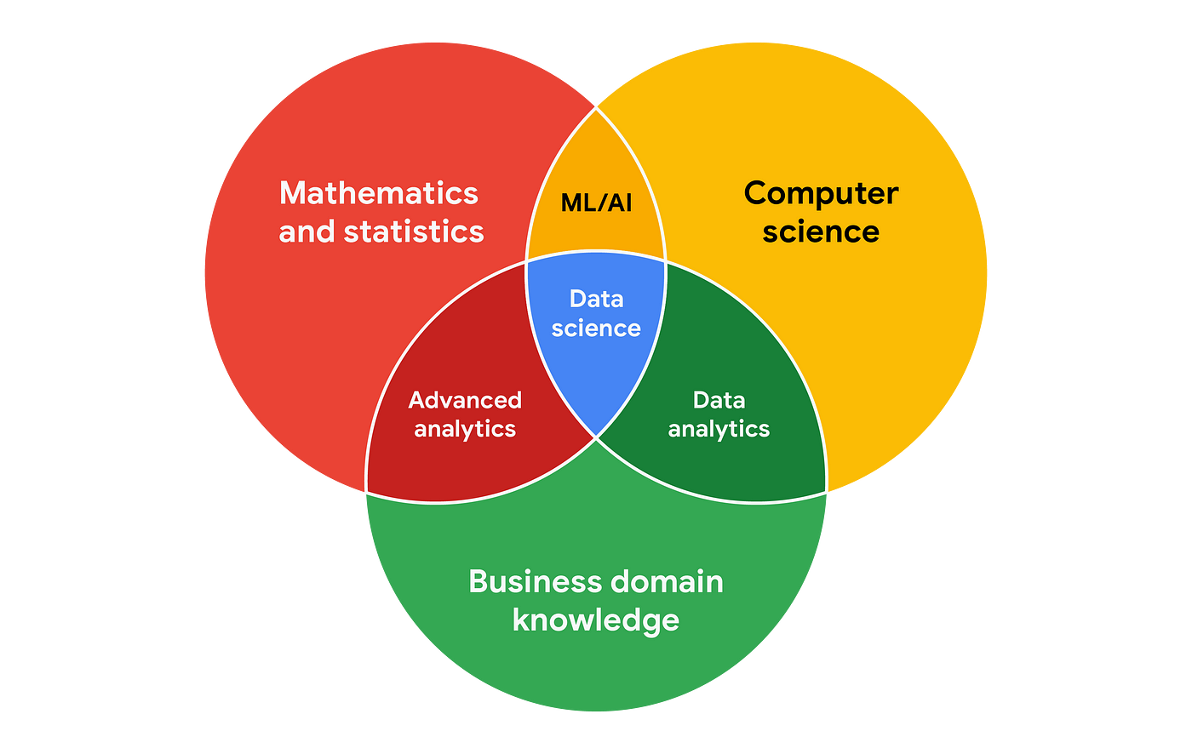
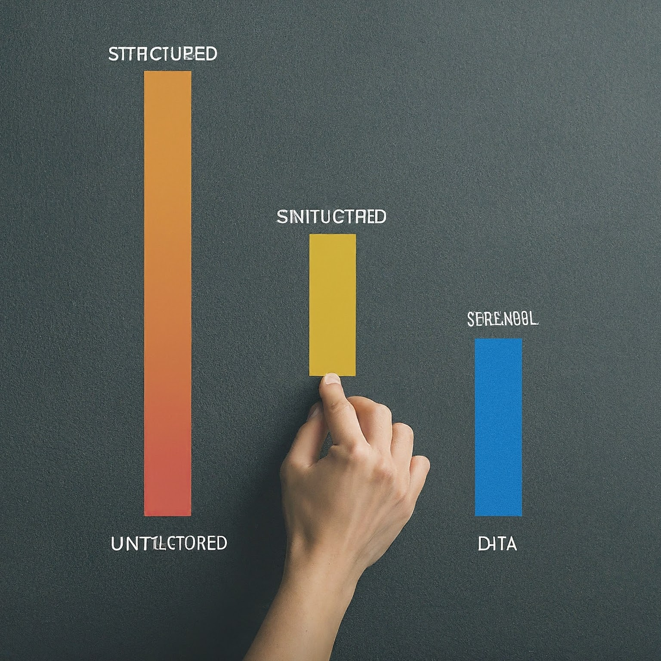
Common Terms in Analytics
Data can be classified into three main types: structured, semi-structured, and unstructured. Structured data is the easiest to analyze, while unstructured data can be the most challenging. However, all types of data can be valuable for analytics projects.

Slide 5
Data: Data is a collection of facts and figures that can be used to represent a real-world object, event, or process.
Structured data: Data that is organized in a predefined format, such as rows and columns in a spreadsheet.
Semi-structured data: Data that has some organization, but does not conform to a strict format, such as JSON or XML files.
Unstructured data: Data that has no predefined format, such as text, images, or videos.

Slide 6
Small data describes data that is specific and inclusive of a short time period. Small data is typically organized and found within spreadsheets. It is simple to collect, store, manage, and represent.
Big Data describes large, less-specific data sets that have been collected and stored over longer periods. Gartner defined Big Data in 2001 as being “high-volume, -velocity, and while incorporating variety…” High-volume is the easiest to see with daily social media generation.
The speed of creation, collection, storage, and processing of numerous data types defines velocity.
Variety could include a person’s LinkedIn, Facebook, Twitter, emails, fitness watch.
Veracity is another term associated with data and defined as the quality and reliability of the data.

Slide 7
Data Wrangling, sometimes referred to as munging, is the process of transforming raw data points into a more appropriate and valuable format to make analysis or a ML model more accurate.
Data (small or big) has a lifecycle. Google utilizes a data lifecycle that includes the six steps of Plan, Capture, Manage, Analyze, Archive, and Destroy.
For Google, the Plan step looks at data needs, who will manage the data, and who has the responsibility to collect it.
Capture is the act of actually collecting the data from a variety of sources. This may be completing surveys, accessing data stored in a relational database, or object oriented database.

Slide 8
Managing data according to Google is the care for data, how and where it is stored, tools to keep the data secure, and how to maintain the data.
Analyzing the data is the process of transforming and organizing the data to draw conclusions, make predictions, drive decision-making, and to answer Key Performance Indicators.
At some point, data will lose immediate value (think unit locations over 5 days old) and needs archiving. This is not to say the information does not have any value, but including it within a dashboard would only add clutter. When archiving, the data is easily retrievable and available for future analysis.
Destruction is the final phase of the data lifecycle.

Slide 9

Classification of Data

Slide 10
Qualitative Data is subjective with an explanatory measure of a quality or characteristic.
Nominal Data is categorized qualitative data without a set or logical order. If 10 Soldiers describe their mood with one word, nominal data is collected.
2.Ordinal Data is qualitative data with a logical order. A doctor’s pain scale is a common example.
Internal data: Data that is collected from within an organization.
External data: Data that is collected from outside an organization.

Slide 11
Quantitative Data is specific and measured objectively.
Interval Data is quantitative, has no zero point and is continuous or discrete.
2.Ratio data is quantitative, has a true zero and is either continuous or discrete.
3.Continuous Data is quantitative, measurable, and has infinite possibilities.
4.Discrete Data is quantitative, measurable, and has limited values such as the number of tanks a unit has. Discrete data will be a whole number.

Slide 12
Data can also be classified into quantitative and qualitative data. Quantitative data is data that can be measured or counted, such as sales figures or customer satisfaction ratings.
Qualitative data is data that describes something, rather than measuring it, such as customer reviews or social media sentiment.
Data can also be classified as internal or external data. Internal data is data that is collected from within an organization, such as sales data or customer records.
External data is data that is collected from outside an organization, such as market research data or social media data.

Slide 13
Relevance in Industry and Need of the Hour
Every industry can leverage the power of data analytics
Make data-driven decisions
Improve efficiency and productivity
Gain a competitive advantage
In today's data-driven world, analytics is no longer a luxury, it is a necessity. Every industry can leverage the power of data analytics to make better decisions, improve efficiency, and gain a competitive advantage. For example, retailers can use analytics to understand customer behavior and target their marketing campaigns more effectively. Financial institutions can use analytics to assess risk and fraud. And healthcare providers can use analytics to improve patient care and outcomes. The need for skilled data analysts and data scientists is growing rapidly, and these skills are in high demand across all industries.

Slide 14
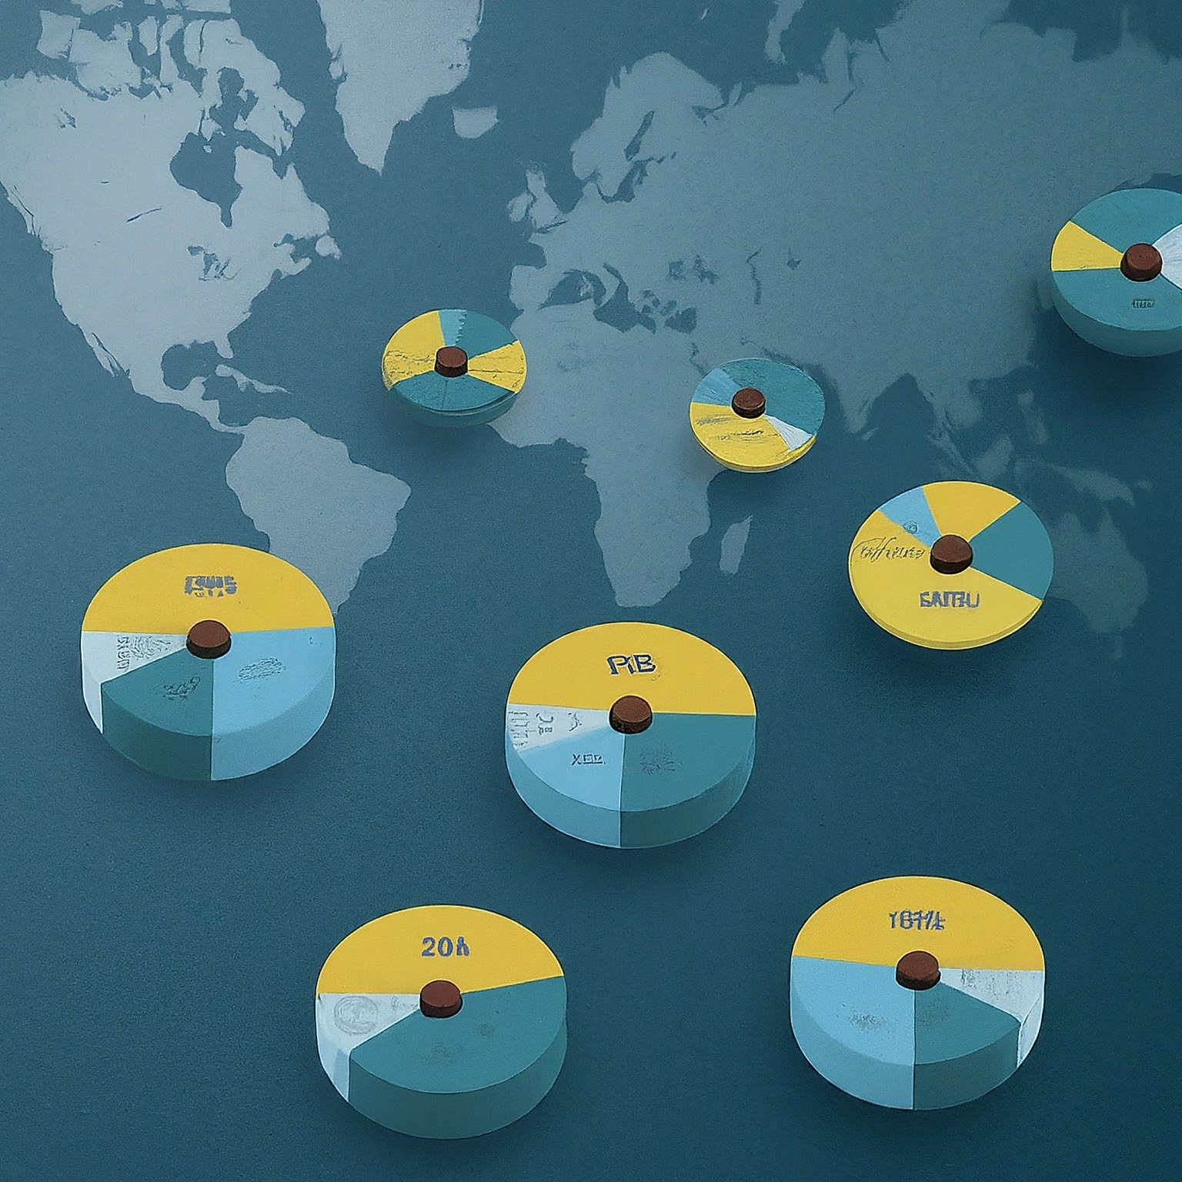
Types of Problems and Business Objectives in Various Industries
Different industries have different problems and objectives
Retail: Improve sales and marketing effectiveness
Finance: Manage risk and fraud
Healthcare: Improve patient care and outcomes
Manufacturing: Increase efficiency and productivity

Slide 15
The types of problems that can be solved with analytics vary depending on the industry.
However, some common business objectives that analytics can help to achieve include: increasing sales and marketing effectiveness, managing risk and fraud, improving patient care and outcomes, and increasing efficiency and productivity.
By understanding the specific problems and objectives of a particular industry, data analysts and data scientists can develop targeted solutions that can have a real impact on the bottom line.

Slide 16

How Leading Companies are Harnessing the Power of Analytics
Netflix uses analytics to personalize recommendations for its subscribers, which has helped to drive subscriber growth and retention.
Amazon uses analytics to optimize its pricing and product recommendations, which has helped to make it the world's largest online retailer.
JPMorgan Chase uses analytics to manage risk and fraud, which has helped to improve the bank's profitability.

Slide 17
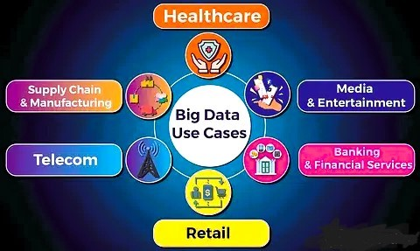
Walmart uses analytics to optimize its supply chain and in-store layout, which has helped to reduce costs and improve customer satisfaction.
Leading companies around the world are using analytics to gain a competitive advantage. These are just a few examples of how analytics can be used to solve real-world business problems.

Slide 18

Critical Success Drivers for Analytics Projects
Executive buy-in: For an analytics project to be successful, it needs to have the support of senior management.
Clear business objectives: The project needs to have clear and well-defined business objectives.
High-quality data: The project needs to have access to high-quality data.
Skilled data scientists and analysts: The project needs to have the right people in place to execute the project.

Slide 19
Effective communication: The results of the project need to be communicated effectively to stakeholders.
Agile and iterative approach: The project needs to be flexible and adaptable to change.
There are a number of critical success factors for analytics projects. First, the project needs to have the support of senior management. Without executive buy-in, the project is unlikely to be successful. Second, the project needs to have clear and well-defined business objectives. What are you hoping to achieve with this project? How will you measure success? Third, the project needs to have access to high-quality data. Garbage in, garbage out. If your data is dirty or inaccurate, your results will be meaningless. Fourth, the project needs to have the right people in place to execute the project. This includes data scientists, data analysts, and business analysts. Fifth, the results of the project need to be communicated effectively to stakeholders. What did you learn? How can the results be used to improve the business? Sixth, the project needs to be flexible and adaptable to change. As you learn more about the data, you may need to change your approach.

Slide 20
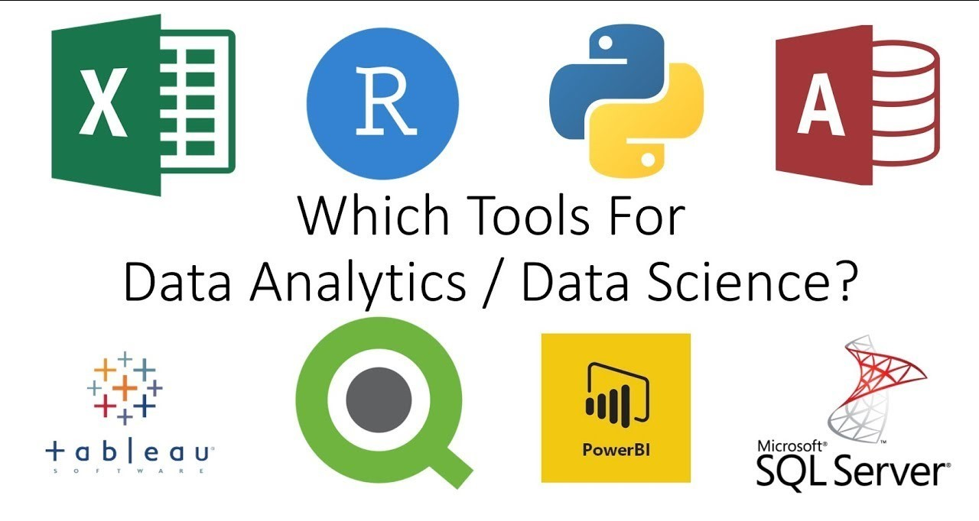
Overview of Analytics Tools & their Popularity

Slide 21
Python: A general-purpose programming language that is popular for data science due to its large ecosystem of libraries and tools, such as NumPy, Pandas, and Scikit-learn.
R: A programming language and software environment specifically designed for statistical computing and graphics.
SQL: A structured query language used to interact with relational databases.
Tableau: A data visualization tool that allows users to create interactive dashboards and reports.
There are a number of different analytics tools available, each with its own strengths and weaknesses. Some of the most popular tools include Python, R, SQL, and Tableau. The best tool for a particular project will depend on the specific needs of the project.

Slide 22
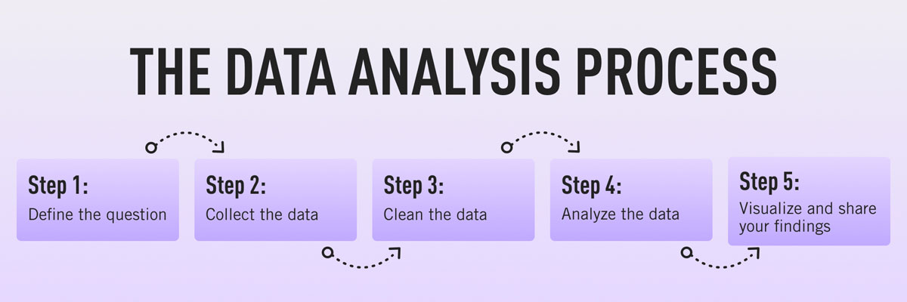
Analytics Methodology & Problem Solving Framework

Slide 23
Define the problem: What are you trying to solve?
Collect data: Identify the data you need and collect it from various sources.
Clean data: Clean and prepare the data for analysis.
Explore data: Get a sense of the data by looking at summaries and visualizations.
Analyze data: Use statistical methods and machine learning to analyze the data.
Communicate results: Communicate the results of your analysis to stakeholders.

Slide 24
There is a general process that can be followed for most analytics projects. This process typically involves the above mentioned steps.
First, you need to define the problem you are trying to solve. What are you hoping to learn from the data? Once you have defined the problem, you need to collect the data you need. This data may come from a variety of sources, such as internal databases, customer surveys, or social media. Once you have collected the data, you need to clean and prepare it for analysis. This may involve removing errors, formatting the data consistently, and dealing with missing values. After you have cleaned the data, you can begin to explore it. This involves getting a sense of the data by looking at summaries and visualizations. Once you have explored the data, you can start to analyze it using statistical methods and machine learning. Finally, you need to communicate the results of your analysis to stakeholders. This may involve creating reports, presentations, or dashboards.

Slide 25
Identify the Most Appropriate Solution Design for the Given Problem Statement
Understand the problem statement thoroughly
Consider the type of data available
Identify the desired outcome
Evaluate the complexity of different solutions
Choose the solution that is most likely to be successful
Once you have defined the problem you are trying to solve, you need to identify the most appropriate solution design. There are a number of factors to consider when making this decision, such as the type of data available, the desired outcome, and the complexity of different solutions. For example, if you are trying to predict customer churn, you might use a machine learning model. However, if you are simply trying to understand customer demographics, you might use a simpler statistical analysis. The best solution design will vary depending on the specific problem you are trying to solve.

Slide 26
Project Plan for Analytics Project & Key Milestones Based on Effort Estimates
Define project scope and objectives
Break down the project into tasks
Estimate the effort required for each task
Develop a timeline for the project
Identify key milestones
Track progress and make adjustments as needed

Slide 27
Once you have identified the most appropriate solution design, you need to develop a project plan. The project plan should define the scope and objectives of the project, break down the project into tasks, estimate the effort required for each task, and develop a timeline for the project. The project plan should also identify key milestones. These are important checkpoints that will help you to track progress and make adjustments as needed. A well-defined project plan is essential for the success of any analytics project.

Slide 28
Build Resource Plan for Analytics Project
Identify the skills required for the project
Assess the availability of internal resources
Determine if you need to hire external resources
Develop a budget for the project
In addition to developing a project plan, you also need to develop a resource plan. The resource plan should identify the skills required for the project and assess the availability of internal resources. You may need to hire external resources if you do not have the necessary skills in-house. The resource plan should also develop a budget for the project. This will include the cost of labor, software, and hardware.

Slide 29

Why Python for Data Science?
Easy to learn and use: Python is a high-level programming language with a clear and concise syntax. This makes it easy to learn and use, even for those with no prior programming experience.

Slide 30
Python is a high-level programming language that is popular for data science for a number of reasons.
First, Python is easy to learn and use. It has a clear and concise syntax that is similar to natural language. This makes it a great choice for beginners and for those who are not programmers by trade.
Second, Python has a large and active community. This means that there are a wealth of resources available online, such as tutorials, documentation, and forums. If you get stuck, you can easily find help from other Python users.
Third, Python has a large ecosystem of libraries and tools for data science. These libraries provide a wide range of functionality for data analysis, machine learning, and data visualization. This makes it easy to get started with data science projects without having to write a lot of code from scratch.

Slide 31
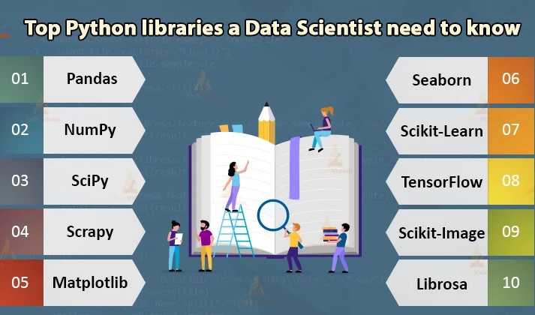
Popular Python Libraries for Data Science

Slide 32
NumPy: Provides fundamental building blocks for numerical computing.
Pandas: Offers powerful data structures for data manipulation and analysis.
Matplotlib: Creates a wide variety of static, animated, and interactive visualizations.
Scikit-learn: Implements a range of machine learning algorithms for classification, regression, clustering, and more.
TensorFlow: An open-source platform for machine learning.

Slide 33
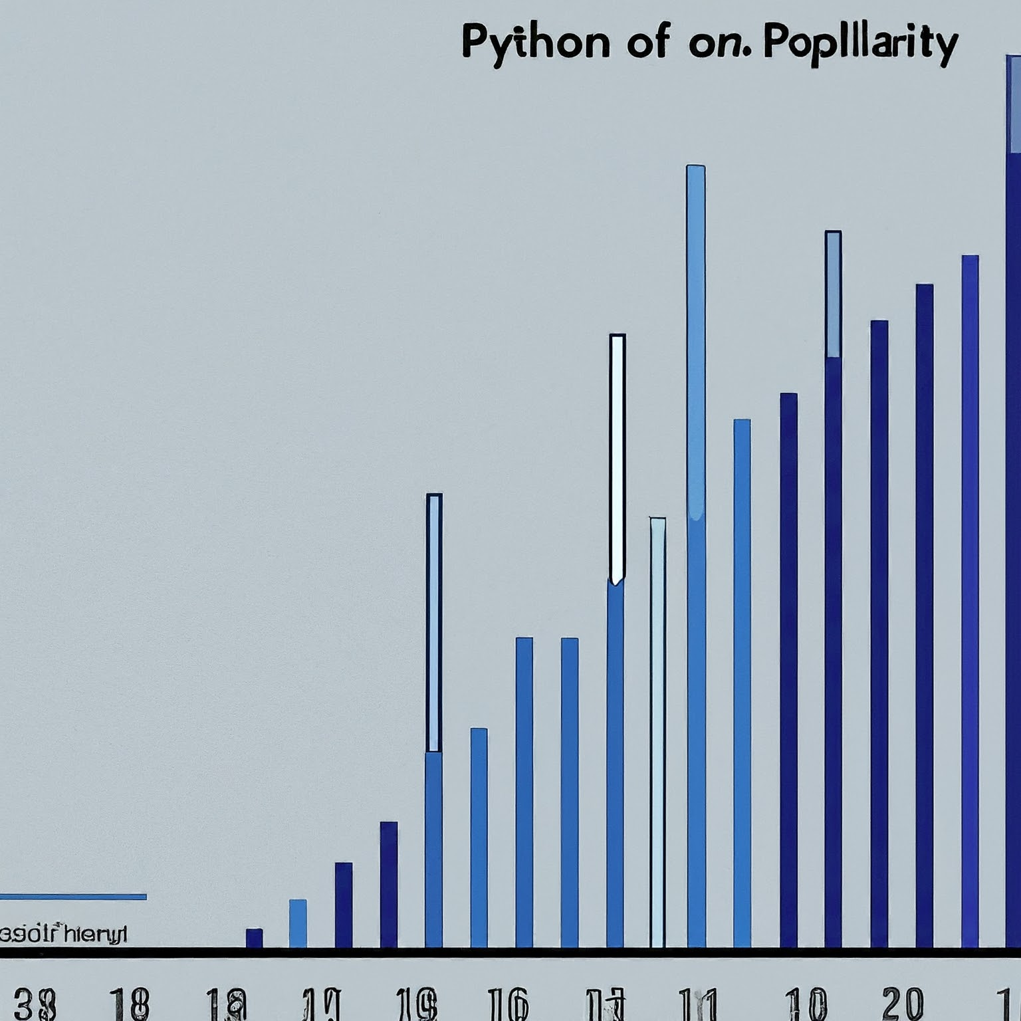
Conclusion
Python is a versatile and powerful programming language that is well-suited for data science.
With its ease of use, large community, and extensive ecosystem of libraries, Python is a great choice for data scientists of all levels.

Slide 34
In conclusion, Python is a versatile and powerful programming language that is well-suited for data science. It is easy to learn and use, has a large and active community, and has a wide range of libraries and tools available. This makes it a great choice for data scientists of all levels. Whether you are a beginner just starting out with data science, or an experienced data scientist working on complex projects, Python can be a valuable tool in your data science toolbox. If you are interested in learning more about data science or Python, there are a wealth of resources available online and in libraries. With a little effort, you can learn the skills you need to use Python for data science and start making sense of your data.

